Slide 1
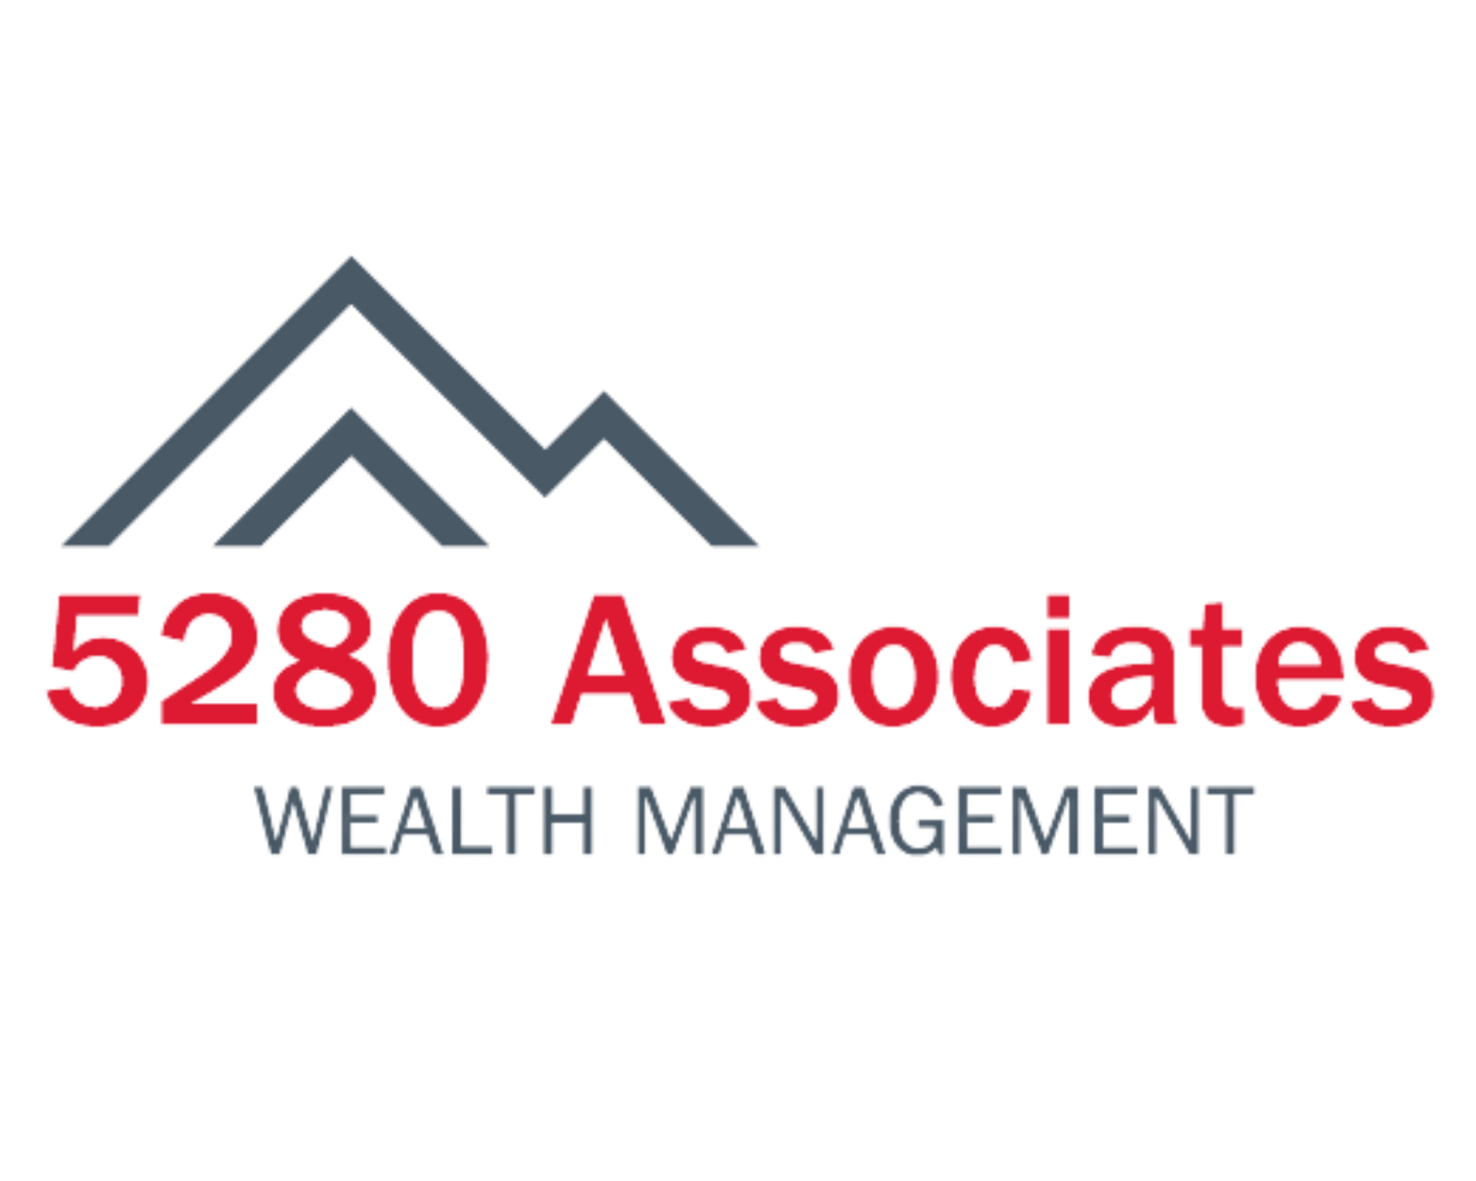
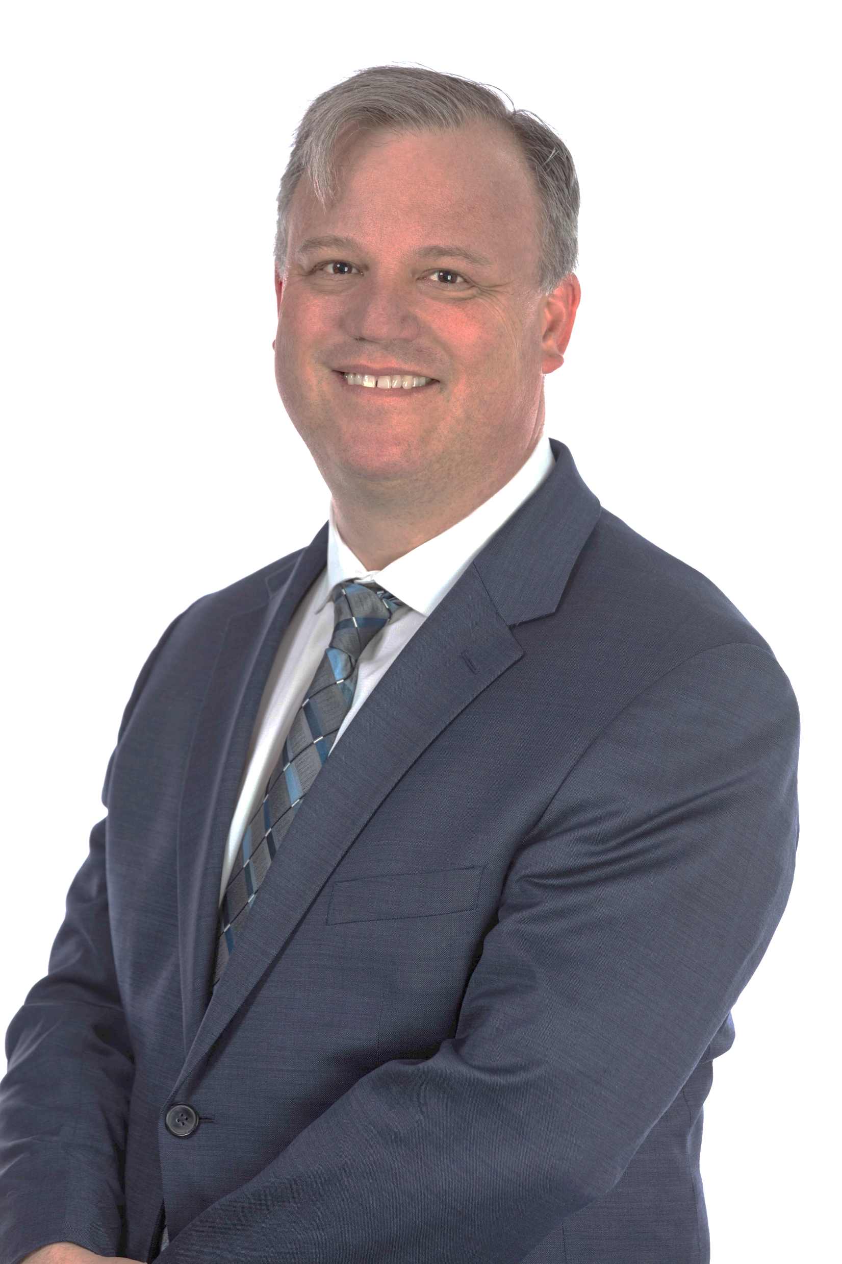
Elevate Webinar 1 Quarterly Market Commentary
with Ted Kouba
Director of Investment Management

Slide 2
January

Slide 3
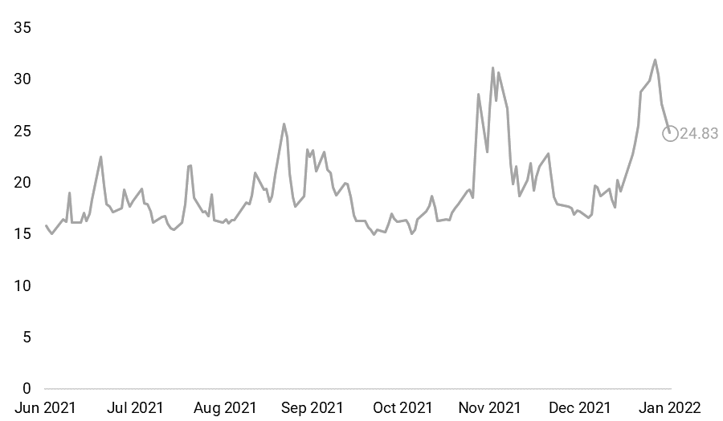
Volatility Returns (again)
WHAT DOES IT MEAN?
Following a bumpy ride from Thanksgiving to mid-December the Santa Claus rally in late December may have made markets a bit too complacent, with a sharp change of course in January.
While December’s volatility mostly owed itself to omicron fears with an inflation backdrop, inflation and the Fed took center stage in January, propelling the S&P 500 down and short-term volatility expectations to the highest in nearly a year.
Equity market pain drives volatility expectations higher
VIX Index, June 30, 2021 to January 31, 2022
Fed, Inflation, and Growth
Omicron fears over Thanksgiving
Source: Helios Quantitative Research, Bloomberg, CNBC
Helios Quantitative Research LLC (“Helios”) is associated with, and under the supervision of, Clear Creek Financial Management, LLC (“Clear Creek”), a Registered Investment Adviser. Advisory services are only offered to clients or prospective clients where Clear Creek, and its representatives are properly licensed or exempt from licensure. This document is solely for informational purposes. Past performance is no guarantee of future returns. Investing involves risk and possible loss of principal capital. No advice may be rendered by Clear Creek or its representatives unless a client service agreement is in place.

Slide 4
Market Overview
EQUITY SECTOR PERFORMANCE
EQUITY STYLE & SIZE PERFORMANCE
CREDIT SECTOR PERFORMANCE
Ranked S&P 500 Sector Total Returns
Ranked Style, Size, and Geography Total Returns
Ranked Fixed Income Sectors Total Returns
SECTOR | JAN
Energy | 19.10%
Financials | 0.06%
Consumer Staples | -1.37%
Utilities | -3.27%
Industrials | -4.73%
S&P 500 | -5.17%
Communication Services | -6.21%
Health Care | -6.76%
Materials | -6.85%
Information Technology | -6.89%
Real Estate | -8.50%
Consumer Discretionary | -9.68%
ASSET CLASS | JAN
Large Cap Value | -2.33%
Emerging Markets | -3.28%
Mid Cap Value | -4.27%
S&P 500 | -5.17%
Large Cap Blend | -5.64%
Developed International | -5.73%
Small Cap Value | -5.83%
Mid Cap Blend | -7.37%
Large Cap Growth | -8.58%
Small Cap Blend | -9.63%
Mid Cap Growth | -12.90%
Small Cap Growth | -13.40%
SECTOR | JAN
U.S. Aggregate 1-3 Year | -0.72%
U.S. Agency | -1.24%
U.S. Treasury | -1.89%
TIPS | -2.02%
Global Aggregate | -2.05%
U.S. Aggregate | -2.15%
Global High Yield | -2.54%
EM Bonds (USD) | -2.63%
U.S. Corporate High Yield | -2.73%
Municipal | -2.74%
U.S. Corporate | -3.37%
U.S. Aggregate 10+ Year | -4.90%
Sector total returns are based on the S&P 500 GICS Level 1 indices.
Asset class total returns are based on the Russell 1000, Russell 1000 Growth, Russell 1000 Value, Russell Midcap, Russell Midcap Growth, Russell Midcap Value, Russell 2000, Russell 2000 Growth, Russell 2000 Value, MSCI EAFE, and MSCI Emerging Markets indices.
Sector total returns are based on the Bloomberg U.S. Aggregate, U.S. Treasury, U.S. Treasury Inflation Notes, U.S. Agency, Municipal, U.S. Corporate, U.S. Corporate High Yield, Global Aggregate, Global High Yield, and EM USD Aggregate indices.
Source: Helios Quantitative Research, Bloomberg
Total returns as of the report date unless otherwise noted. Returns over 1 year are annualized. Indices are unmanaged and cannot be invested into directly. The returns do not reflect fees, sales charges, or expenses and don’t reflect any particular investment. Past performance is not indicative of future results.
Helios Quantitative Research LLC (“Helios”) is associated with, and under the supervision of, Clear Creek Financial Management, LLC (“Clear Creek”), a Registered Investment Adviser. Advisory services are only offered to clients or prospective clients where Clear Creek, and its representatives are properly licensed or exempt from licensure. This document is solely for informational purposes. Past performance is no guarantee of future returns. Investing involves risk and possible loss of principal capital. No advice may be rendered by Clear Creek or its representatives unless a client service agreement is in place.

Slide 5
Shifting Expectations on Fed Policy
WHAT DOES IT MEAN?
The Fed has been a constant topic in the market over the last several months and only more so in January. How aggressive the Fed may move to tackle inflation has been a constant source of debate and speculation.
When the Fed accelerated the rate of tapering due to sustained inflation reports, it significantly raised the likelihood of March being the liftoff from the 0% current lower target.
Following the January FOMC meeting, the market shifted its expectations around rate policy with Powell appearing willing to undertake back-to-back rate hikes later in the year.
Market Now Expects five hikes from the Fed in 2022
Probabilities of Fed rate policy target, derived from Fed futures market
2.00% - 2.25% |  |  |  |  |  |  | 0.9%
1.75% - 2.00% |  |  |  |  |  | 1.5% | 8.5%
1.50% - 1.75% |  |  |  |  | 4.2% | 13.7% | 25.5%
1.25% - 1.50% |  |  |  | 7.0% | 30.3% | 34.4% | 34.1%
1.00% - 1.25% |  |  | 11.8% | 45.8% | 41.6% | 33.9% | 22.6%
0.75% - 1.00% |  | 12.5% | 68.8% | 38.8% | 20.3% | 14.2% | 7.4%
0.50% - 0.75% | 15.3% | 72.2% | 18.6% | 8.0% | 3.4% | 2.2% | 1.0%
0.25% - 0.50% | 84.7% | 15.3% | 0.9% | 0.4% | 0.1% | 0.1%
0.00% - 0.25%
 | Mar. 16 | May 4 | Jun. 15 | Jul. 27 | Sep. 21 | Nov. 2 | Dec. 14
 | Meeting Date
Source: Helios Quantitative Research, Bloomberg, CME FedWatch Tool from 01/31/22
Helios Quantitative Research LLC (“Helios”) is associated with, and under the supervision of, Clear Creek Financial Management, LLC (“Clear Creek”), a Registered Investment Adviser. Advisory services are only offered to clients or prospective clients where Clear Creek, and its representatives are properly licensed or exempt from licensure. This document is solely for informational purposes. Past performance is no guarantee of future returns. Investing involves risk and possible loss of principal capital. No advice may be rendered by Clear Creek or its representatives unless a client service agreement is in place.

Slide 6
February

Slide 7
Market Overview
EQUITY SECTOR PERFORMANCE
EQUITY STYLE & SIZE PERFORMANCE
CREDIT SECTOR PERFORMANCE
Ranked S&P 500 Sector Total Returns
Ranked Style, Size, and Geography Total Returns
Ranked Fixed Income Sectors Total Returns
SECTOR | FEB
Energy | 7.14%
Industrials | -0.87%
Health Care | -1.02%
Materials | -1.24%
Financials | -1.35%
Consumer Staples | -1.42%
Utilities | -1.85%
S&P 500 | -3.00%
Consumer Discretionary | -3.99%
Information Technology | -4.90%
Real Estate | -5.02%
Communication Services | -6.98%
ASSET CLASS | FEB
Small Cap Value | 1.65%
Small Cap Blend | 1.07%
Small Cap Growth | 0.43%
Mid Cap Value | -0.47%
Mid Cap Blend | -0.72%
Large Cap Value | -1.16%
Mid Cap Growth | -1.21%
Developed International | -1.77%
Large Cap Blend | -2.74%
Emerging Markets | -2.99%
S&P 500 | -3.00%
Large Cap Growth | -4.25%
SECTOR | FEB
TIPS | 0.85%
Municipal | -0.36%
U.S. Aggregate 1-3 Year | -0.45%
U.S. Treasury | -0.66%
U.S. Agency | -0.67%
U.S. Corporate High Yield | -1.03%
U.S. Aggregate | -1.12%
Global Aggregate | -1.19%
U.S. Corporate | -2.00%
Global High Yield | -2.39%
U.S. Aggregate 10+ Year | -2.53%
EM Bonds (USD) | -4.54%
Sector total returns are based on the S&P 500 GICS Level 1 indices.
Asset class total returns are based on the Russell 1000, Russell 1000 Growth, Russell 1000 Value, Russell Midcap, Russell Midcap Growth, Russell Midcap Value, Russell 2000, Russell 2000 Growth, Russell 2000 Value, MSCI EAFE, and MSCI Emerging Markets indices.
Sector total returns are based on the Bloomberg U.S. Aggregate, U.S. Treasury, U.S. Treasury Inflation Notes, U.S. Agency, Municipal, U.S. Corporate, U.S. Corporate High Yield, Global Aggregate, Global High Yield, and EM USD Aggregate indices.
Source: Helios Quantitative Research, Bloomberg
Total returns as of the report date unless otherwise noted. Returns over 1 year are annualized. Indices are unmanaged and cannot be invested into directly. The returns do not reflect fees, sales charges, or expenses and don’t reflect any particular investment. Past performance is not indicative of future results.
Helios Quantitative Research LLC (“Helios”) is associated with, and under the supervision of, Clear Creek Financial Management, LLC (“Clear Creek”), a Registered Investment Adviser. Advisory services are only offered to clients or prospective clients where Clear Creek, and its representatives are properly licensed or exempt from licensure. This document is solely for informational purposes. Past performance is no guarantee of future returns. Investing involves risk and possible loss of principal capital. No advice may be rendered by Clear Creek or its representatives unless a client service agreement is in place.

Slide 8
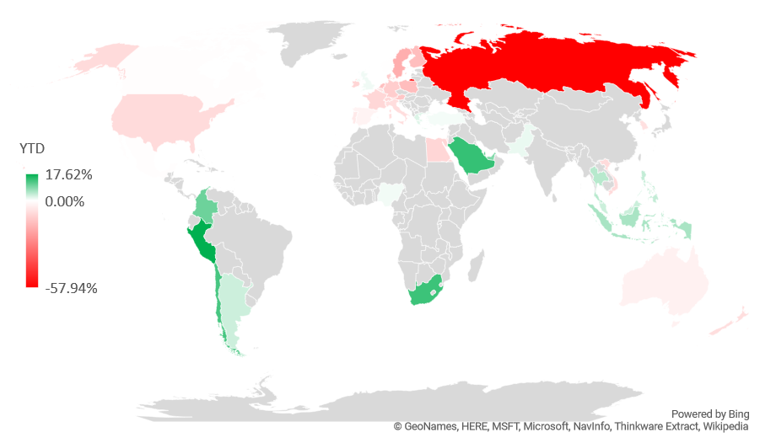
Russia’s Weight in Global Markets
WHAT DOES IT MEAN?
Much of the focus on the impacts stemming from the invasion of Ukraine are not focused on the economic damage to the countries, but rather on energy. This makes sense given Russia’s equity market is extremely small on the global stage, however, it produces a significant amount of oil and natural gas.
Looking at the ETF ACWI, which tracks the MSCI ACWI, Russian equities hold a 0.36% weight within the ETF which is slightly smaller than South Africa, Saudi Arabia and less than half the weighting of Sweden.
Equity market pain drives volatility expectations higher
Total Returns of Selected Country ETFs, December 31, 2021 to February 28, 2022
Fed, Inflation, and Growth
Omicron fears over Thanksgiving
YTD IMPACT ON ACWI
0.36%
Allocation to Russian Equities
-57.94%
Russian Performance
-0.23%
Attribution to Russia
Source: Helios Quantitative Research, Bloomberg
Helios Quantitative Research LLC (“Helios”) is associated with, and under the supervision of, Clear Creek Financial Management, LLC (“Clear Creek”), a Registered Investment Adviser. Advisory services are only offered to clients or prospective clients where Clear Creek, and its representatives are properly licensed or exempt from licensure. This document is solely for informational purposes. Past performance is no guarantee of future returns. Investing involves risk and possible loss of principal capital. No advice may be rendered by Clear Creek or its representatives unless a client service agreement is in place.

Slide 9
Expectations on Fed Policy
WHAT DOES IT MEAN?
The market still has its eyes focused on Fed policy and how quickly rates may change throughout the year to combat inflation. So, we should keep an eye on the market’s expectations as well.
As we have seen in recent months, expectations can shift quickly and when they do, the market tends to experience bouts of volatility. In doing so, it adjusts the value of future earnings and the attractiveness for companies to invest.
Earlier, there was shifting expectations of whether the Fed would hike 50-basis points in March. However, that has since dissipated, and expectations are now solidly in the 25-basis point camp.
Market Now Expects five to six hikes
Probabilities of Fed rate policy target, derived from Fed futures market
2.25% - 2.50% |  |  |  |  |  |  | 0.1%
2.00% - 2.25% |  |  |  |  |  | 0.2% | 2.8%
1.75% - 2.00% |  |  |  |  | 0.4% | 4.1% | 17.3%
1.50% - 1.75% |  |  |  | 0.7% | 7.7% | 23.9% | 34.8%
1.25% - 1.50% |  |  | 1.1% | 11.9% | 40.2% | 40.3% | 30.7%
1.00% - 1.25% |  | 1.0% | 18.5% | 56.9% | 40.3% | 25.9% | 12.4%
0.75% - 1.00% |  | 18.0% | 80.4% | 30.5% | 11.3% | 5.7% | 1.9%
0.50% - 0.75% | 10.4% | 81.0%
0.25% - 0.50% | 89.6%
 | Mar. 16 | May 4 | Jun. 15 | Jul. 27 | Sep. 21 | Nov. 2 | Dec. 14
 | Meeting Date
Source: Helios Quantitative Research, Bloomberg, CME FedWatch Tool from 02/28/22
Helios Quantitative Research LLC (“Helios”) is associated with, and under the supervision of, Clear Creek Financial Management, LLC (“Clear Creek”), a Registered Investment Adviser. Advisory services are only offered to clients or prospective clients where Clear Creek, and its representatives are properly licensed or exempt from licensure. This document is solely for informational purposes. Past performance is no guarantee of future returns. Investing involves risk and possible loss of principal capital. No advice may be rendered by Clear Creek or its representatives unless a client service agreement is in place.

Slide 10
March

Slide 11
Market Overview
EQUITY SECTOR PERFORMANCE
EQUITY STYLE & SIZE PERFORMANCE
CREDIT SECTOR PERFORMANCE
Ranked S&P 500 Sector Total Returns
Ranked Style, Size, and Geography Total Returns
Ranked Fixed Income Sectors Total Returns
SECTOR | MAR
Utilities | 10.36%
Energy | 8.93%
Real Estate | 7.79%
Materials | 6.11%
Health Care | 5.56%
Consumer Discretionary | 4.91%
S&P 500 | 3.71%
Information Technology | 3.49%
Industrials | 3.38%
Consumer Staples | 1.81%
Communication Services | 0.95%
Financials | -0.19%
ASSET CLASS | MAR
Large Cap Growth | 3.91%
S&P 500 | 3.71%
Large Cap Blend | 3.37%
Mid Cap Value | 3.04%
Large Cap Value | 2.82%
Mid Cap Blend | 2.56%
Small Cap Value | 1.95%
Mid Cap Growth | 1.61%
Small Cap Blend | 1.24%
Developed International | 0.64%
Small Cap Growth | 0.45%
Emerging Markets | -2.26%
SECTOR | MAR
Global High Yield | -0.86%
U.S. Corporate High Yield | -1.15%
U.S. Aggregate 1-3 Year | -1.36%
TIPS | -1.86%
EM Bonds (USD) | -2.34%
U.S. Agency | -2.35%
U.S. Corporate | -2.52%
U.S. Aggregate | -2.78%
Global Aggregate | -3.05%
U.S. Treasury | -3.11%
Municipal | -3.24%
U.S. Aggregate 10+ Year | -3.93%
Sector total returns are based on the S&P 500 GICS Level 1 indices.
Asset class total returns are based on the Russell 1000, Russell 1000 Growth, Russell 1000 Value, Russell Midcap, Russell Midcap Growth, Russell Midcap Value, Russell 2000, Russell 2000 Growth, Russell 2000 Value, MSCI EAFE, and MSCI Emerging Markets indices.
Sector total returns are based on the Bloomberg U.S. Aggregate, U.S. Treasury, U.S. Treasury Inflation Notes, U.S. Agency, Municipal, U.S. Corporate, U.S. Corporate High Yield, Global Aggregate, Global High Yield, and EM USD Aggregate indices.
Source: Helios Quantitative Research, Bloomberg
Total returns as of the report date unless otherwise noted. Returns over 1 year are annualized. Indices are unmanaged and cannot be invested into directly. The returns do not reflect fees, sales charges, or expenses and don’t reflect any particular investment. Past performance is not indicative of future results.
Helios Quantitative Research LLC (“Helios”) is associated with, and under the supervision of, Clear Creek Financial Management, LLC (“Clear Creek”), a Registered Investment Adviser. Advisory services are only offered to clients or prospective clients where Clear Creek, and its representatives are properly licensed or exempt from licensure. This document is solely for informational purposes. Past performance is no guarantee of future returns. Investing involves risk and possible loss of principal capital. No advice may be rendered by Clear Creek or its representatives unless a client service agreement is in place.

Slide 12
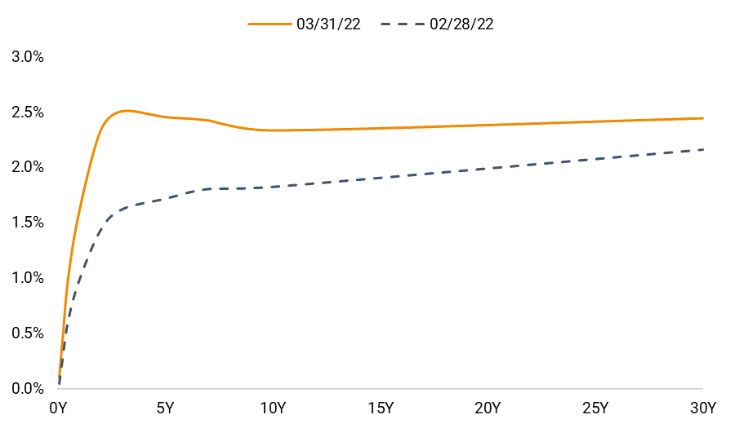
Short-End of the Yield Curve Rises
WHAT DOES IT MEAN?
Over recent months, the yield curve has flattened as near-term expectations for Fed policy rose.
These expectations rose considerably following the FOMC meeting in March, pushing the yield curve upward, though the short-end rose considerably more than the longer-dated yields.
The 3-year yield rose to the highest point along the yield curve, creating the inversion we can see in the graph on the right.
See slide 11 for a look at the market’s expectations of Fed policy.
Short End of the U.S. Yield Curve inverts
March 31, 2022 versus February 28, 2022
Source: Helios Quantitative Research, Bloomberg
Helios Quantitative Research LLC (“Helios”) is associated with, and under the supervision of, Clear Creek Financial Management, LLC (“Clear Creek”), a Registered Investment Adviser. Advisory services are only offered to clients or prospective clients where Clear Creek, and its representatives are properly licensed or exempt from licensure. This document is solely for informational purposes. Past performance is no guarantee of future returns. Investing involves risk and possible loss of principal capital. No advice may be rendered by Clear Creek or its representatives unless a client service agreement is in place.

Slide 13
Looking at Past Yield Curve Inversions
WHAT DOES IT MEAN?
Looking at past yield curve inversions, we can see that the predictive power of an inverted yield curve is not perfect. While inversions do tend to prelude recessions, they may do so by a year or more, and sometimes nearly three years. Further, equity performance following inversions appears random and is not an indicator of future equity performance.
The selected dates do not include every inversion, once the yield curve inverts it can tend to bounce around over the subsequent months.
History of inversions and recessions (Continued)
Selected inversions of the U.S. government 10-year and 2-year yields
 |  | S&P 500 Total Return from Inversion Date
Inversion Date | Days to Next Recession | 6 Month | 1 Year | 3 Year (Annualized)
08/17/78 | 532 | -3.49% | 8.80% | 13.87%
09/11/80 | 323 | 8.57% | 1.67% | 15.75%
12/14/88 | 594 | 19.74% | 31.92% | 15.64%
08/11/89 | 354 | -1.62% | 0.67% | 10.32%
05/26/98 | 1,040 | 8.94% | 20.95% | 6.65%
02/02/00 | 423 | 2.69% | -1.39% | -14.14%
12/27/05 | 734 | -0.46% | 15.73% | -9.59%
04/13/07 | 262 | 8.48% | -6.38% | -4.13%
08/26/19 | 187 | 13.14% | 21.96% | n/a
Source: Helios Quantitative Research, Bloomberg, NBER
Helios Quantitative Research LLC (“Helios”) is associated with, and under the supervision of, Clear Creek Financial Management, LLC (“Clear Creek”), a Registered Investment Adviser. Advisory services are only offered to clients or prospective clients where Clear Creek, and its representatives are properly licensed or exempt from licensure. This document is solely for informational purposes. Past performance is no guarantee of future returns. Investing involves risk and possible loss of principal capital. No advice may be rendered by Clear Creek or its representatives unless a client service agreement is in place.

Slide 14
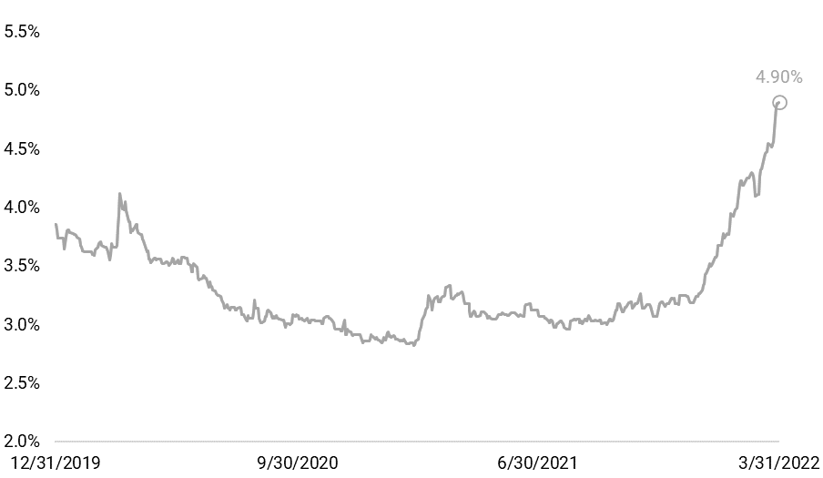
Mortgage Rates Respond
WHAT DOES IT MEAN?
Average rates on 30-year fixed mortgages have shot up recently, increasing over 100 basis points since the end of January and pushing the average to the highest since 2011.
The increase in borrowing costs would typically dampen a hot housing market and put downward pressure on prices but continued low inventories may lessen these impacts.
According to data from the Mortgage Bankers Association, refinancing applications have already begun to cool, though purchase applications, while off their peak, are showing initial resilience to the increased rates.
Mortgage rates surge, putting pressure on housing market
Average U.S. 30-year fixed mortgage rate, December 31, 2019 to March 31, 2022
Source: Helios Quantitative Research, Bloomberg, Bankrate.com
Helios Quantitative Research LLC (“Helios”) is associated with, and under the supervision of, Clear Creek Financial Management, LLC (“Clear Creek”), a Registered Investment Adviser. Advisory services are only offered to clients or prospective clients where Clear Creek, and its representatives are properly licensed or exempt from licensure. This document is solely for informational purposes. Past performance is no guarantee of future returns. Investing involves risk and possible loss of principal capital. No advice may be rendered by Clear Creek or its representatives unless a client service agreement is in place.

Slide 15
Expectations on Fed Policy
WHAT DOES IT MEAN?
The market still has its eyes focused on Fed policy and how quickly rates may change throughout the year to combat inflation.
Over the last few months, we have seen expectations shift quickly and the market is now expecting multiple 50 basis point rate hikes this year.
At the current probabilities implied by the Fed futures market, by the end of the year, the Fed’s policy rate will be 2.50% to 2.75% This would signal a 250-basis point increase from where it stood just last month.
Market Now Multiple 50 bps hikes
Probabilities of Fed rate policy target, derived from Fed futures market
3.25% - 3.50% |  |  |  |  |  |  | 0.1%
3.00% - 3.25% |  |  |  |  |  |  | 3.5%
2.75% - 3.00% |  |  |  |  |  | 0.3% | 22.3%
2.50% - 2.75% |  |  |  |  | 0.3% | 7.3% | 40.4%
2.25% - 2.50% |  |  |  |  | 7.5% | 40.3% | 27.2%
2.00% - 2.25% |  |  |  | 5.8% | 41.3% | 40.4% | 6.3%
1.75% - 2.00% |  |  |  | 41.2% | 40.4% | 11.3% | 0.2%
1.50% - 1.75% |  |  |  | 41.9% | 10.5% | 0.3%
1.25% - 1.50% |  |  | 63.5% | 11.1%
1.00% - 1.25% |  |  | 26.7%
0.75% - 1.00% |  | 68.8%
0.50% - 0.75% |  | 31.2%
0.25% - 0.50% | 100.0%
 | Mar. 16 | May 4 | Jun. 15 | Jul. 27 | Sep. 21 | Nov. 2 | Dec. 14
 | Meeting Date
Source: Helios Quantitative Research, Bloomberg, CME FedWatch Tool from 03/31/22
Helios Quantitative Research LLC (“Helios”) is associated with, and under the supervision of, Clear Creek Financial Management, LLC (“Clear Creek”), a Registered Investment Adviser. Advisory services are only offered to clients or prospective clients where Clear Creek, and its representatives are properly licensed or exempt from licensure. This document is solely for informational purposes. Past performance is no guarantee of future returns. Investing involves risk and possible loss of principal capital. No advice may be rendered by Clear Creek or its representatives unless a client service agreement is in place.

Slide 16
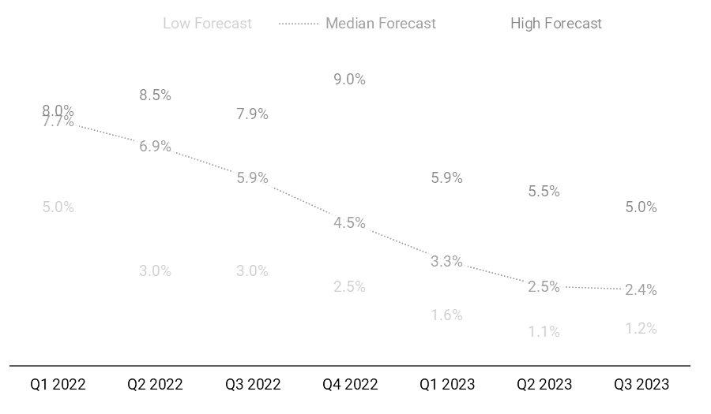
Keeping An Eye On Inflation Expectations
WHAT DOES IT MEAN?
Inflation continues to be a hot topic, and one likely in the mind of many investors. With that in mind, we want to keep an eye on how economists are viewing inflation.
A similar pattern of changing forecasts happened this month as in many other recent months. Near-term inflation has crept up, closer to the previous high forecasts, with the high forecasts nudging upwards as well.
The expectation of inflation cooling has continually been getting pushed out as inflation remains stubbornly high.
Year-over-year Consumer price index (CPI) Expectations
Economists surveyed by Bloomberg, latest as of March 31, 2022
Source: Helios Quantitative Research, Bloomberg
Helios Quantitative Research LLC (“Helios”) is associated with, and under the supervision of, Clear Creek Financial Management, LLC (“Clear Creek”), a Registered Investment Adviser. Advisory services are only offered to clients or prospective clients where Clear Creek, and its representatives are properly licensed or exempt from licensure. This document is solely for informational purposes. Past performance is no guarantee of future returns. Investing involves risk and possible loss of principal capital. No advice may be rendered by Clear Creek or its representatives unless a client service agreement is in place.

Slide 17
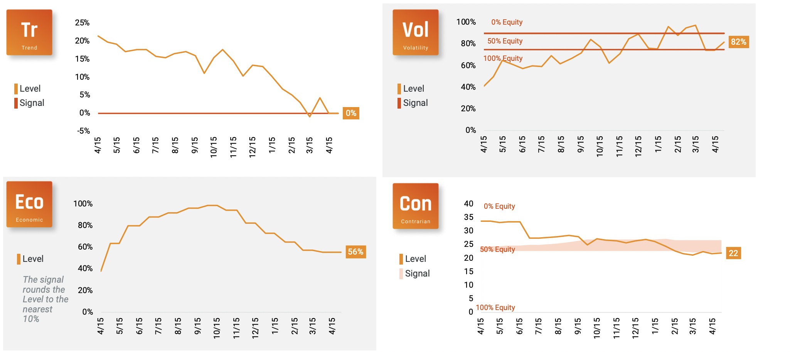
Ecosystem 2.0 Update
Source: Helios Quantitative Research, Bloomberg
Helios Quantitative Research LLC (“Helios”) is associated with, and under the supervision of, Clear Creek Financial Management, LLC (“Clear Creek”), a Registered Investment Adviser. Advisory services are only offered to clients or prospective clients where Clear Creek, and its representatives are properly licensed or exempt from licensure. This document is solely for informational purposes. Past performance is no guarantee of future returns. Investing involves risk and possible loss of principal capital. No advice may be rendered by Clear Creek or its representatives unless a client service agreement is in place.

Slide 18
Definitions & Disclosures
This commentary is produced by Helios Quantitative Research LLC (“Helios”) and is for informational purposes only. Helios Quantitative Research LLC (“Helios”) is associated with, and under the supervision of, Clear Creek Financial Management, LLC (“Clear Creek”), a Registered Investment Advisor. Helios provides research services to financial advisors who have executed a written agreement with Clear Creek or its representatives. The research, analysis, and views reflected in this commentary are subject to change at any time without notice.
Nothing in this commentary constitutes investment advice, performance data, or any recommendation of a particular security, portfolio of securities, or investment strategy as suitable for any specific person and is intended for use only by a third-party financial advisor, with other information, as an input in the development of investment advice for its own clients. Financial advisors are responsible for providing customized investment advice for each of their clients based on their unique risk tolerance and financial circumstances. Helios is not responsible for determining whether this commentary is applicable or suitable for financial advisor’s clients or for providing customized recommendations for any of financial advisor’s clients. Such financial advisors are responsible for making their own independent judgment as to how to use this information. Financial advisors must determine whether or not the securities are appropriate for their clients as Clear Creek and its representatives do not consider investor suitability when determining investment opinions. Only an investor and their financial advisor know enough about their circumstances to make an investment decision. Neither Clear Creek nor its representatives have investment discretion over or place trade orders for any portfolios or accounts derived from this information. Any mention of a particular security and related performance data is not a recommendation to buy or sell that security. There is no guarantee that any security illustrated will be successful or achieve any particular level of results.
Any presentation of back-tested performance are hypothetical, were compiled after the end of the period advertised, and do not represent decisions made by Helios during the period described. Advisory services are only offered to clients or prospective clients where Clear Creek and its representatives are properly licensed or exempt from licensure.
Past performance is no guarantee of future returns. Investing involves risk and possible loss of principal capital.
Helios Adaptive Index, Helios Alpha Index, Helios Equity Index, Helios Dynamic Risk 5% Index, Helios Dynamic Risk 7% Index, Helios Dynamic Risk 10% Index, Helios Dynamic Risk 13% Index, Helios Dynamic Risk 16% Index, Helios Turnkey 10 Index, Helios Turnkey 30 Index, Helios Turnkey 50 Index, Helios Turnkey 70 Index, Helios Turnkey 90 Index, Helios Fixed Income Index, and Helios Strategic Income Index (collectively the “Helios Indices”) is the property of Helios Quantitative Research LLC, which has contracted with S&P Opco, LLC (a subsidiary of S&P Dow Jones Indices LLC) to calculate and maintain the Helios Indices. The Helios Indices are not sponsored by S&P Dow Jones Indices or its affiliates or its third party licensors (collectively, “S&P Down Jones Indices”). S&P Dow Jones Indices will not be liable for any errors or omissions in calculating the Helios Indices. “Calculated by S&P Down Jones Indices” and the related stylized mark(s) are service marks of S&P Dow Jones Indices and have been licensed for use by Helios Quantitative Research LLC. S&P® is a registered trademark of Standard & Poor’s Financial Services LLC (“SPFS”), and Dow Jones® is a registered trademark of Dow Jones Trademark Holdings LLC (“Dow Jones”).
© 2022 Helios Quantitative Research LLC. All rights reserved.

Slide 19
Definitions & Disclosures
5280 Associates is a part of Thrivent Advisor Network, LLC ("Thrivent"), a Registered Investment Adviser ("RIA"), located in the State of Minnesota. Thrivent provides investment advisory and related services for clients nationally. Thrivent will maintain all applicable registration and licenses as required by the various states in which Thrivent conducts business, as applicable. Thrivent renders individualized responses to persons in a particular state only after complying with all regulatory requirements, or pursuant to an applicable state exemption or exclusion
Advisory Persons of Thrivent provide advisory services under a practice name or “doing business as” name or may have their own legal business entities. However, advisory services are engaged exclusively through Thrivent Advisor Network, LLC, a registered investment adviser. 5280 Associates and Thrivent Advisor Network, LLC are not affiliated companies. Information in this message is for the intended recipient[s] only. Please visit our website www.5280associates.com for important disclosures.
Securities offered through Purshe Kaplan Sterling Investments(“PKS”), Member FINRA/SIPC. PKS is headquartered at 80 State Street, Albany, NY 12207. PKS and 5280 Associates are not affiliated companies.
Any specific securities identified and described do not represent all of the securities purchased, sold, or recommended for advisory clients. The reader should not assume that investments in the securities identified and discussed were or will be profitable. A summary description of the principal risks of investing in a particular model is available upon request. There can be no assurance that a model will achieve its investment objectives. Investment strategies employed by the advisor in selecting investments for the model portfolio may not result in an increase in the value of your investment or in overall performance equal to other investments. The model portfolio’s investment objectives may be changed at any time without prior notice. Portfolio allocations are based on a model portfolio, which may not be suitable for all investors. Clients should also consider the transactions costs and/or tax consequences that might result from rebalancing a model portfolio. Frequent rebalancing may incur additional costs and/or tax consequences versus less rebalancing. Please notify us if there have been any changes to your financial situation or your investment objectives, or if you would like to place or modify any reasonable restrictions on the management of your account.
Different types of investments involve varying degrees of risk. Therefore, it should not be assumed that future performance of any specific investment or investment strategy will be profitable.
Investment advisory services offered through Thrivent Advisor Network, LLC., a registered investment adviser and a subsidiary of Thrivent. Clients will separately engage a broker-dealer or custodian to safeguard their investment advisory assets. Review the Thrivent Advisor Network ADV Disclosure Brochure and Wrap-Fee Program Brochure for a full description of services, fees, and expenses. Thrivent Advisor Network LLC advisors may also be registered representatives of a broker-dealer to offer securities products.
The material presented includes information and opinions provided by a party not related to Thrivent Advisor Network. It has been obtained from sources deemed reliable; but no independent verification has been made, nor is its accuracy or completeness guaranteed. The opinions expressed may not necessarily represent those of Thrivent Advisor Network or its affiliates. They are provided solely for information purposes and are not to be construed as solicitations or offers to buy or sell any products, securities, or services. They also do not include all fees or expenses that may be incurred by investing in specific products. Past performance is no guarantee of future results. Investments will fluctuate and when redeemed may be worth more or less than when originally invested. You cannot invest directly in an index. The opinions expressed are subject to change as subsequent conditions vary. Thrivent Advisor Network and its affiliates accept no liability for loss or damage of any kind arising from the use of this information.
This communication may include forward looking statements. Specific forward-looking statements can be identified by the fact that they do not relate strictly to historical or current facts and include, without limitation, words such as “may,” “will,” “expects,” “believes,” “anticipates,” “plans,” “estimates,” “projects,” “targets,” “forecasts,” “seeks,” “could’” or the negative of such terms or other variations on such terms or comparable terminology. These statements are not guarantees of future performance and involve risks, uncertainties, assumptions and other factors that are difficult to predict and that could cause actual results to differ materially.

Slide 20
Definitions & Disclosures
Index Benchmarks presented within this report may not reflect factors relevant for your portfolio or your unique risks, goals or investment objectives. Past performance of an index is not an indication or guarantee of future results. It is not possible to invest directly in an index.
The Bloomberg Emerging Markets USD Aggregate Bond Index is a flagship hard currency Emerging Markets debt benchmark that includes fixed and floating-rate U.S. dollar-denominated debt issued from sovereign, quasi-sovereign, and corporate EM issuers.
The Bloomberg Global Aggregate® Index is a flagship measure of global investment grade debt from twenty-four local currency markets. This multi-currency benchmark includes treasury, government-related, corporate and securitized fixed-rate bonds from both developed and emerging markets issuers.
The Bloomberg Global High Yield Index is a multi-currency flagship measure of the global high yield debt market. The index represents the union of the U.S. High Yield, the Pan-European High Yield, and Emerging Markets (EM) Hard Currency High Yield Indices.
The Bloomberg U.S. Agency Index includes native currency agency debentures from issuers such as Fannie Mae, Freddie Mac, and Federal Home Loan Bank.
The Bloomberg U.S. Aggregate Bond® Index, or the Agg, is a broad base, market capitalization-weighted bond market index representing intermediate term investment grade bonds traded in the United States. Investors frequently use the index as a stand-in for measuring the performance of the U.S. bond market.
The Bloomberg U.S. Corporate Bond Index measures the investment grade, fixed-rate, taxable corporate bond market. It includes USD denominated securities publicly issued by U.S. and non-U.S. industrial, utility and financial issuers.
The Bloomberg U.S. Corporate High Yield Bond® Index measures the USD-denominated, high yield, fixed-rate corporate bond market. Securities are classified as high yield if the middle rating of Moody's, Fitch and S&P is Ba1/BB+/BB+ or below.
The Bloomberg U.S. Municipal® Index covers the USD-denominated long-term tax-exempt bond market. The index has four main sectors: state and local general obligation bonds, revenue bonds, insured bonds and pre-refunded bonds.
The Bloomberg U.S. Treasury Bond® Index includes public obligations of the U.S. Treasury, i.e. U.S. government bonds. Certain Treasury bills are excluded by a maturity constraint. In addition, certain special issues, such as state and local government series bonds (SLGs), as well as U.S. Treasury TIPS, are excluded.
The Bloomberg U.S. Treasury Inflation-Linked Bond Index (Series-L) measures the performance of the U.S. Treasury Inflation Protected Securities (TIPS) market. Federal Reserve holdings of U.S. TIPS are not index eligible and are excluded from the face amount outstanding of each bond in the index.
The Consumer Price Index (CPI) is a measure of the average change over time in the prices paid by urban consumers for a market basket of consumer goods and services.
The MSCI ACWI (All Country World Index) is a stock index designed to track broad global equity-market performance. Maintained by Morgan Stanley Capital International (MSCI), the index is comprised of the stocks of about 3,000 companies from 23 developed countries and 26 emerging markets.

Slide 21
Definitions & Disclosures
The MSCI EAFE® Index is a broad market index of stocks located within countries in Europe, Australasia, and the Middle East.
The MSCI Emerging Markets® Index is a selection of stocks that is designed to track the financial performance of key companies in fast-growing nations.
The Russell 1000® Index represents the top 1000 companies by market capitalization in the United States.
The Russell 1000 Growth® Index measures the performance of the Russell 1000® 's growth segment, which is defined to include firms whose share prices have higher price-to-book ratios and higher expected earnings growth rates.
The Russell 1000 Value® Index measures the performance of the large-cap value segment of the U.S. equity universe. It includes those Russell 1000® companies with lower price-to-book ratios and lower expected and historical growth rates.
The Russell 2000® Index measures the performance of the 2,000 smaller companies that are included in the Russell 3000® Index, which itself is made up of nearly all U.S. stocks. The Russell 2000® is widely regarded as a bellwether of the U.S. economy because of its focus on smaller companies that focus on the U.S. market.
The Russell 2000 Growth® Index measures the performance of the small- cap growth segment of the U.S. equity universe. It includes those Russell 2000® companies with higher price-to-value ratios and higher forecasted growth values.
The Russell 2000 Value® Index measures the performance of the small-cap segment of the U.S. equity universe. It includes those Russell 2000® companies with lower price-to-book ratios and lower forecasted growth values.
The Russell 3000 Index is a market-capitalization-weighted equity index maintained by FTSE Russell that provides exposure to the entire U.S. stock market. The index tracks the performance of the 3,000 largest U.S.-traded stocks, which represent about 97% of all U.S.-incorporated equity securities.
The Russell Midcap® Index is a market capitalization-weighted index comprised of 800 publicly traded U.S. companies with market caps of between $2 and $10 billion. The 800 companies in the Russell Midcap® Index are the 800 smallest of the 1,000 companies that comprise Russell 1000® Index.
The S&P 500® Index, or the Standard & Poor's 500® Index, is a market-capitalization-weighted index of the 500 largest U.S. publicly traded companies.
The Federal Open Market Committee (FOMC) is the branch of the Federal Reserve System that determines the direction of monetary policy.

